Slide 1
FYP5: Object Detection, Tracking and Suspicious Activity Recognition for Maritime Surveillance using Thermal Vision

Slide 2
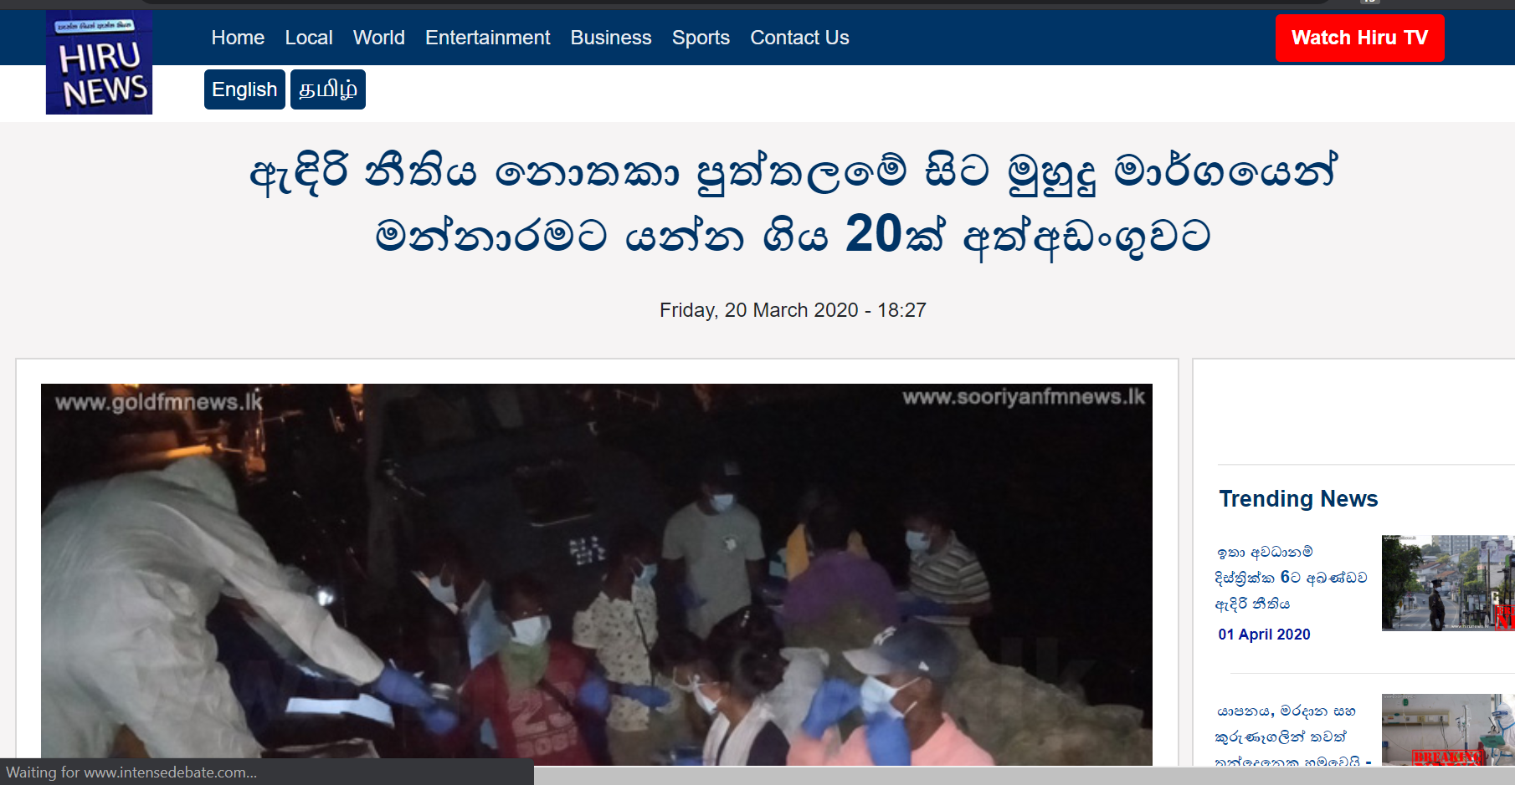
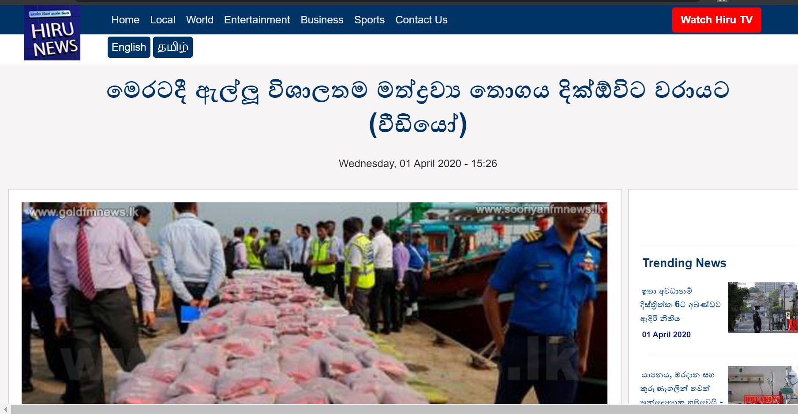
Keeping a watchful eye at Sea

Slide 3
Weekly Tasks
Object Detection using other models
Go through the identified topics of ISP
Literature review on Suspicious Activity Recognition
Horizon Detection

Slide 4
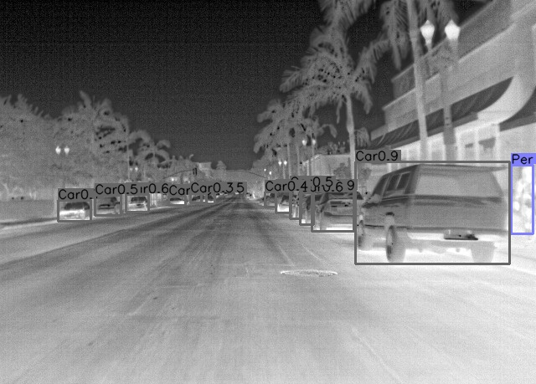
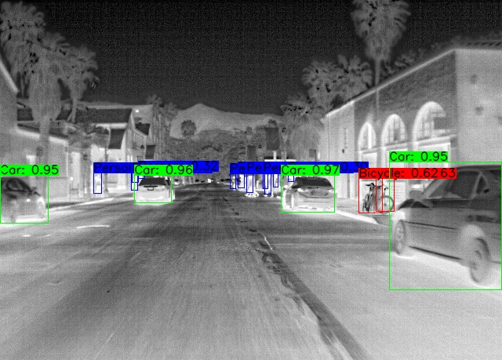
Object Detection Yolo
Object Detection CenterNet

Slide 5
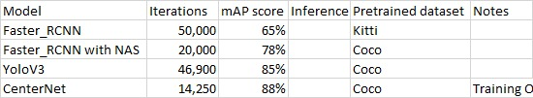
Analysis of models used so far

Slide 6
Control System Concepts
State Space Introduction
State equation writing for SISO and MIMO
Servo systems – position feedback and velocity feedback
Robotic manipulators
Rigid Body Motions (Position and Rotation)
Parameterization of Rotation (Euler Angles, Roll Pitch Yaw angles)
Homogeneous Transformation

Slide 7
PID Controller Design
PID controller design for object tracking
Using image processing algos for tracking object and using a control loop to move the camera
Kalman FIlters and use

Slide 8
Suspicious Activity Recognition
Foreground object detection
Background Modelling
Change detection Approach
Object Tracking
Non-Tracking
Tracking
Feature extraction
Object classification
Object analysis

Slide 9

Tasks for next week
Go through the identified topics of ISP
Literature review on Suspicious Activity Recognition
Prepare the flow diagram

